Slide 1



Faith and Belief on Campus: Division and Cohesion
Keynote: Freedom of Speech in Universities,
David Isaac CBE, Chair of the Equality and Human Rights Commission
#beliefoncampus
WiFi: WiFi Guest
WiFi troubleshooting: wifisupport@bskyb.com

Slide 2
Faith and Belief on Campus: Division and Cohesion:
Ben Ryan, Theos
@BenedictWRyan
#beliefoncampus
WiFi: WiFi Guest
WiFi troubleshooting: wifisupport@bskyb.com

Slide 3
Why this research?
Universities as battlefields
Contested identities and the next generation
#beliefoncampus
WiFi: WiFi Guest
WiFi troubleshooting: wifisupport@bskyb.com

Slide 4
Why this research?
What role do faith and belief societies play on their campuses? Who are the members, what do they do, and how do they work with their key stakeholders (students, staff, university managers, students’ unions and chaplaincies)?
How do faith and belief societies address the key issues with which they are concerned: including nurturing and promoting their religious identity, campaigning about particular causes, ensuring freedom of speech and maintaining good relations with those outside their society?
How effective are faith and belief societies, and what lessons can be learned to enable universities to foster more peaceful relations and a liberal public space on campus?
#beliefoncampus
WiFi: WiFi Guest
WiFi troubleshooting: wifisupport@bskyb.com

Slide 5
What we did
3 data gathering exercises
72 student interviewees
9 staff and student union interviewees
15 event observations
5 national body interviews
#beliefoncampus
WiFi: WiFi Guest
WiFi troubleshooting: wifisupport@bskyb.com

Slide 6
What we did
 | Category Description | Typical characteristics
Category 1 | Traditional, elite universities (‘Traditional Elite’) | Foundation in 19th Century or earlier Typically significantly smaller proportion of state school educated students than other categories
Category 2 | Inner-city redbrick universities (‘Red Brick’) | Foundation in early 20th Century Located in large cities
Category 3 | 1960s campus universities (‘1960s Campus’) | Foundation in 1960s Purpose-built campuses
Category 4 | Post-1992 universities, former polytechnics (‘Post-1992’) | Granted university status since 1992, actual foundation can be much earlier Location variable, can include both purpose-built out-of-town campuses and city centre locations Students overwhelmingly state school educated
Category 5 | Cathedrals Group universities (‘Cathedrals Group’) | Universities and university colleges with church foundation Granted university status after 1992, founded in late 19th Century Students overwhelmingly state school educated

Slide 7
The big picture
888 Faith and Belief Societies
6.3 Per University
>18,000 full members
#beliefoncampus
WiFi: WiFi Guest
WiFi troubleshooting: wifisupport@bskyb.com

Slide 8
Differences between university categories
University type | Total faith and belief societies | Average number of societies (exercise A) | Average number of societies (exercise B)
Traditional Elite | 188 | 9* | 7*
Red Brick | 176 | 10 | 12
1960s Campus | 162 | 6.5 | 10
Post-1992 | 309 | 5 | 6
Cathedrals Group | 49 | 3 | 3

Slide 9
Faith breakdown
MUSLIM (Combined) | 128
Islamic Society | 102
Ahlul Bayt (Shia Islam) | 26
CHRISTIAN (Combined) | 393
Christian Union | 140
Catholic | 52
First Love (Pentecostal) | 22
Pentecostal/Charismatic/Evangelical (combined count across all societies, not including Christian Unions) | 179
Jewish | 50
Hindu | 47
Sikh | 41
Atheist/Humanist/Secularist | 29
Buddhist | 23
Krishna Consciousness | 22

Slide 10
Societies by size
Society | Average size | Largest single society
Yoga | 108 | 396
Islamic | 90 | Over 800
Hindu | 60 | 260
Meditation | 54 | 85
Christian Union | 43 | 127
Sikh | 37 | 173
First Love | 17 | 71

Slide 11
Activities of faith and belief societies
Providing space to practise, learn about and develop students’ religion or belief
Building community and friendships. Crucial sites for combatting loneliness and supporting students with poor mental health
Providing pastoral and spiritual support
Opportunities for women’s leadership and exploration of women’s issues
Giving back to the wider community in terms of social action and charitable fundraising
#beliefoncampus
WiFi: WiFi Guest
WiFi troubleshooting: wifisupport@bskyb.com

Slide 12
“Our parents and grandparents would tell us all the stories and the history behind our religion and stuff but obviously we didn’t really pay much attention… but now we’re trying to discover it a bit more and we’re kind of falling into religion a bit more.” (Cathedrals Group university, Sikh Society member)
“My religion is Hindu, it’s never been a simple religion, it’s always been very complex...It’s taken me a very long time to understand it as well… It’s like, ‘Hey, do you know what? I want to know why we do things, I want to know why I do this, why I don’t do this’… I’ve even stopped looking at Hinduism as a religion, it is more of a way of life to be honest.” Cathedrals Group university, Hindu Society member)

Slide 13
“I didn’t know anyone who was Sikh on campus… I was alone
and that aloneness really hit me in the first few weeks of living here, because I was living here… the story goes that I went to this spot somewhere on campus, a really nice reflective place, and then just prayed and I was really upset, I needed to find some people that were like me at least .As soon as I had finished doing my prayer someone messages me straightaway on Facebook… it was a girl and she was like, ‘Oh, would you like to start a Sikh Society?’ and I was like, ‘How is this even possible?’ (Cathedrals Group university, Sikh Society member)

Slide 14
“I have people phoning me up, in the middle of the night, and they’re like, ‘This is what I’m going through today’. And they just need an ear to listen to. And I always try to open that up to them. I’m like, ‘Look spirituality or religion isn’t about judgment because God doesn’t really judge, it’s about us trying to listen to each other and really hear about what’s going on’. So if there’s anything to do with sex, drugs, violence at home, whatever, I’m here to listen to that so I can help you go to the right avenues about it.” (Cathedrals Group university, Sikh Society member)

Slide 15
Challenges facing faith and belief
Societies:
Dr Kristin Aune, Coventry University
@drkristinaune
#beliefoncampus
WiFi: WiFi Guest
WiFi troubleshooting: wifisupport@bskyb.com

Slide 16
Patchy support from universities and students’ unions
Lack of provision of needed space or resources, including lack of accommodation for the society’s practices
Organisational and funding issues
Low levels of participation
Non-members’ misconceptions about the society
Internal divisions over sectarian, denominational or ethnic orientations
Lack of capacity to undertake interfaith activities, and lack of external support to help organise those activities
#beliefoncampus
WiFi: WiFi Guest
WiFi troubleshooting: wifisupport@bskyb.com

Slide 17
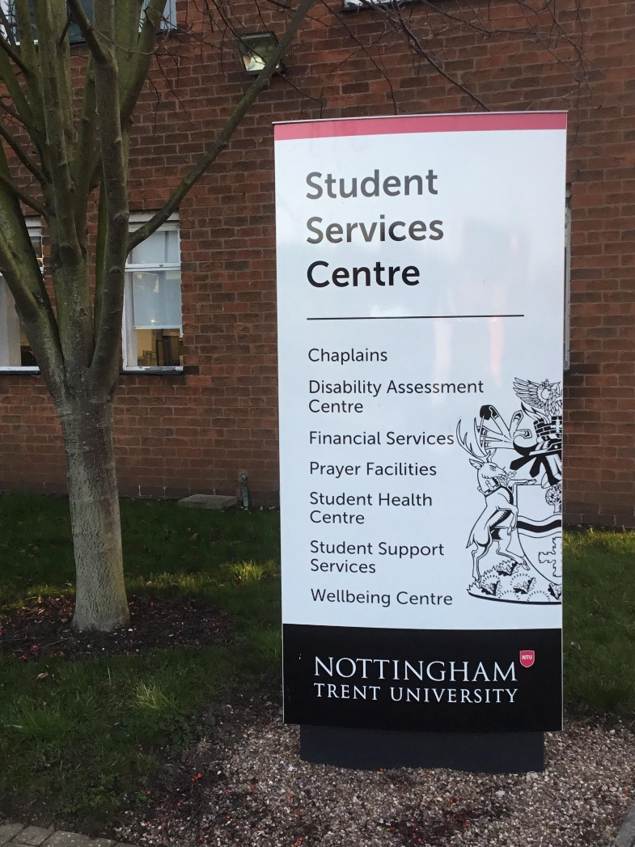
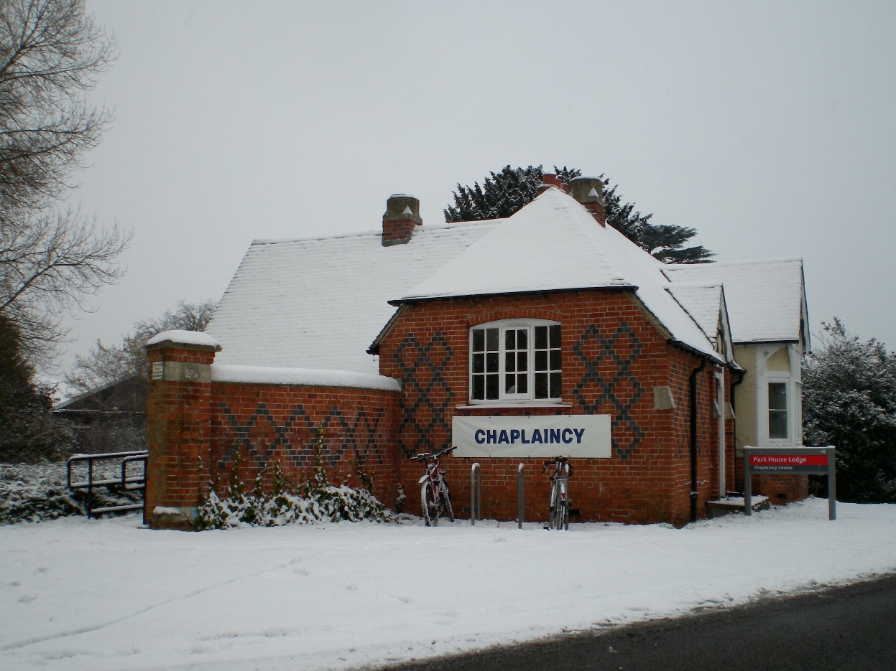
Support from universities

Slide 18
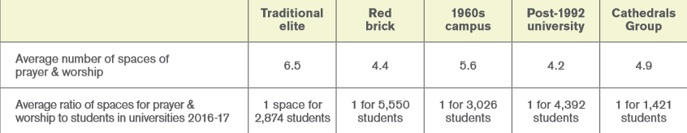
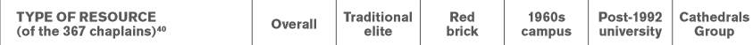
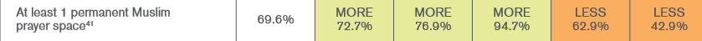
Space and facilities for religion and belief
Provision of prayer and worship spaces across 5 university types
Range of resources provided by universities to chaplains and to religion on campus more generally, highlighting where universities provide more or less than the national figure

Slide 19

Support from students’ unions
“Universities could do better to integrate these groups into their activities and promotions, as faith groups are sometimes treated suspiciously, or held at arms length despite the universities often promoting their supposed diversity. (Students’ union, written response to survey)”
#beliefoncampus
WiFi: WiFi Guest
WiFi troubleshooting: wifisupport@bskyb.com

Slide 20
“Different institutions’ approaches to faith and belief differ so much in terms of how much the institution sees this [interfaith work] as a priority. Like who on campus has responsibility to do that work, and in general, we find that it often slips through the cracks. Students’ unions tend to focus on the four ‘liberation’ categories: BME, women, disabilities, and LGBTQ. If they are doing this kind of work, their staff is generally focused on these four areas, and interfaith can get messed up a bit. Some of the best people that we work with on campus are just individuals who are really passionate about faith and belief… And it might be quite a small part of their job, but they have chosen to prioritise it.” (Faith & Belief Forum, staff member)
#beliefoncampus
WiFi: WiFi Guest
WiFi troubleshooting: wifisupport@bskyb.com

Slide 21
Interfaith work
“The Islamic Society, the first event we did was like a desserts and cakes night. We met on campus, and there must have been about 30 odd people - not many from the JSOC. But that was really really nice to meet some of their members and stuff, and actually that helped me a bit with Israel Society because I hadn't been relating to Islam and I knew a couple of their members. So that's been really good. I think that might be at first; I don't remember that happening last year. We were supposed to do another one - a talk. I don't think I went to that, but it was supposed to be a talk as part of religious week or something like that, like religion on campus.”
Q: It's nice you had the event with the Islamic Society. Was that quite easy to organize or were there any challenges around that?

Slide 22
“...I just remember there being a couple of issues. Not with the actual Islamic society; they were really easy, really chilled. I think they're a bit more religious than us; so we just had to be a bit careful about what we were eating. But to be honest, it's not that bad, because we know what's kosher and all Muslims can eat kosher food. At the actual event, there just weren't many of us, many of the Jews there, because we hadn't really advertised it well. But in terms of actually organizing it with them, I think they were really easy. Really really nice group of people. Something I noticed on their Facebook page - there's no politics or anything involved. They're completely spiritual. They're not interested in the politics; no political drama or anything like that at all.” (Jsoc committee member, Red Brick)
#beliefoncampus
WiFi: WiFi Guest
WiFi troubleshooting: wifisupport@bskyb.com

Slide 23
“The aim was to mainly just create this place for education about different religious groups and so that we can get away from any misunderstandings that people have about other belief systems. It was just meant to be this peaceful environment where you can just go and educate yourself and meet other people and just talk about these topics which can sometimes be quite heated but in an environment that was comfortable for everyone. That’s what we really do, we hold lectures, the occasional social and there’s usually quite a lot of interest from theology students….”
#beliefoncampus
WiFi: WiFi Guest
WiFi troubleshooting: wifisupport@bskyb.com

Slide 24
“It’s been quite good, it’s been very positive so far and the best part, it honestly is just being able to speak with people about these things, very openly, because there’s not really another venue. There are religious societies but they are very focussed on their own faith usually, so this kind of tries to bridge that gap. Through the people I've met, it is these conversations I've had and the understanding that it creates, that’s what has been the most positive experience for me in the Society so far.” (Interfaith Society president, Scottish Traditional Elite university)
#beliefoncampus
WiFi: WiFi Guest
WiFi troubleshooting: wifisupport@bskyb.com

Slide 25
Barriers to interfaith work
Not prioritised by student faith and belief societies
Logistical difficulties, including:
  Lack of university or students’ union staff with interfaith as a key remit
  Jostling for limited space
#beliefoncampus
WiFi: WiFi Guest
WiFi troubleshooting: wifisupport@bskyb.com

Slide 26
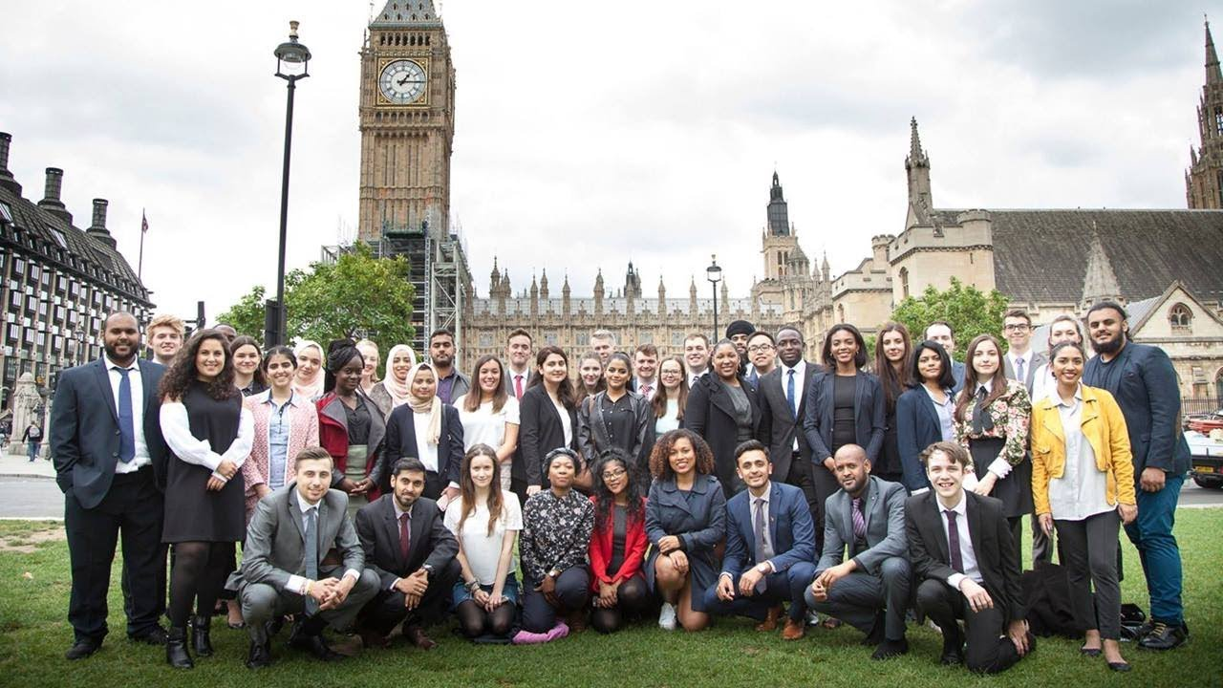

ParliaMentors

Slide 27
Social capital – bonding and bridging
“Connections among individuals – social networks and the norms of reciprocity and trustworthiness that arise from them”
“Bridging social capital can generate broader identities and reciprocity, whereas bonding social capital bolsters our narrower selves”
(Robert Putnam, Bowling Alone, 2000)
#beliefoncampus
WiFi: WiFi Guest
WiFi troubleshooting: wifisupport@bskyb.com

Slide 28
Handling controversial issues:
Simon Perfect, Theos
@simplymrperfect
Freedom of speech
External speakers
Gender and sexuality issues
Proselytism
Prejudice and hate crime
#beliefoncampus
WiFi: WiFi Guest
WiFi troubleshooting: wifisupport@bskyb.com

Slide 29
Freedom of speech
Universities – strong legal duty to uphold freedom of speech within the law as far as reasonably practicable (Education No. 2 Act 1986)
Most students feel free to express their views – 83% agree (HEPI survey 2016)
Freedom of speech on campus is not in crisis, but minority of students feel under pressure to self-censor
#beliefoncampus
WiFi: WiFi Guest
WiFi troubleshooting: wifisupport@bskyb.com

Slide 30
Prevent Duty
Universities – duty to “have due regard to the need to prevent people from being drawn into terrorism” (Counter-Terrorism and Security Act 2015)
NUS survey 2018 of 578 Muslim students – 1/3 felt negatively affected by Prevent
#beliefoncampus
WiFi: WiFi Guest
WiFi troubleshooting: wifisupport@bskyb.com

Slide 31
“…when Prevent was about to be enforced, the union was very insistent on, ‘We want to have a meeting with you guys’, but it’s just the agenda of the meeting didn’t seem very welcoming in that sense. We were very hesitant because we don’t know what they’re going to say and it just felt they wanted to be like, ‘We’re imposing Prevent, we’re going to be looking more into your things’, it just felt like an invasion of our privacy… By speaking to the ISOC I feel like that’s targeting us by linking us to radicalisation and extremism” (1960s Campus university, Islamic Society member)
#beliefoncampus
WiFi: WiFi Guest
WiFi troubleshooting: wifisupport@bskyb.com

Slide 32
Gender and sexuality issues
E.g. women in leadership – some Christian Unions
E.g. gender segregation – some Islamic Societies
Students feeling under pressure to put on public performance of conservatism to fit in with society
“I felt like I had to wear an abaya, or I felt like I had to stop talking to guys”. (English Traditional Elite university, Islamic Society)
#beliefoncampus
WiFi: WiFi Guest
WiFi troubleshooting: wifisupport@bskyb.com

Slide 33
Proselytism / faith-sharing
In general, proselytism met with amicable or indifferent responses rather than hostility
Students broadly tolerant of proselytism, ‘live and let live’
“I don’t think the Anglican Society can be one of these guys that just stands out there shouting the word of God or dragging people in off the street. The way that it has been is to stand back and let people come to you.” (Scottish Traditional Elite university, Anglican Society member)
#beliefoncampus
WiFi: WiFi Guest
WiFi troubleshooting: wifisupport@bskyb.com

Slide 34
Prejudice and hate crime
NUS survey 2018 of 578 Muslims – 1/3 worried about experiencing abuse on campus
NUS survey 2016-17 of 485 Jewish students – 26% worried, 23% had actually experienced abuse perceived to be Antisemitic
Before starting her course her grandparents had advised her not to go, as it is “a notoriously Antisemitic uni”; the experience made her “feel that people were right in what they were saying and that I didn’t really belong there”.
#beliefoncampus
WiFi: WiFi Guest
WiFi troubleshooting: wifisupport@bskyb.com

Slide 35
Recommendations
Faith and belief societies
  Increase frequency of interfaith collaboration
Universities
  Provide suitable resources and facilities for all major religions or beliefs, including chaplains
Students’ unions
  Assign a permanent member of staff a ‘religion or belief’ brief
Universities and students’ unions
  Prioritise upholding of freedom of speech as far as is reasonable when carrying out duties
#beliefoncampus
WiFi: WiFi Guest
WiFi troubleshooting: wifisupport@bskyb.com

